Slide 1

Micromagnetics with ubermag
WARNING: This is a presentation PDF and does not have animations. For a MacOS Keynote presentation, ask Marijan.
Marijan Beg¹, Ryan A. Pepper¹, and Hans Fangohr^{1,2}
¹University of Southampton, Highfield, SO17 1BJ Southampton, United Kingdom
²European XFEL GmbH, Holzkoppel 4, 22869 Schenefeld, Germany
Last updated: 25 June 2020

Slide 2
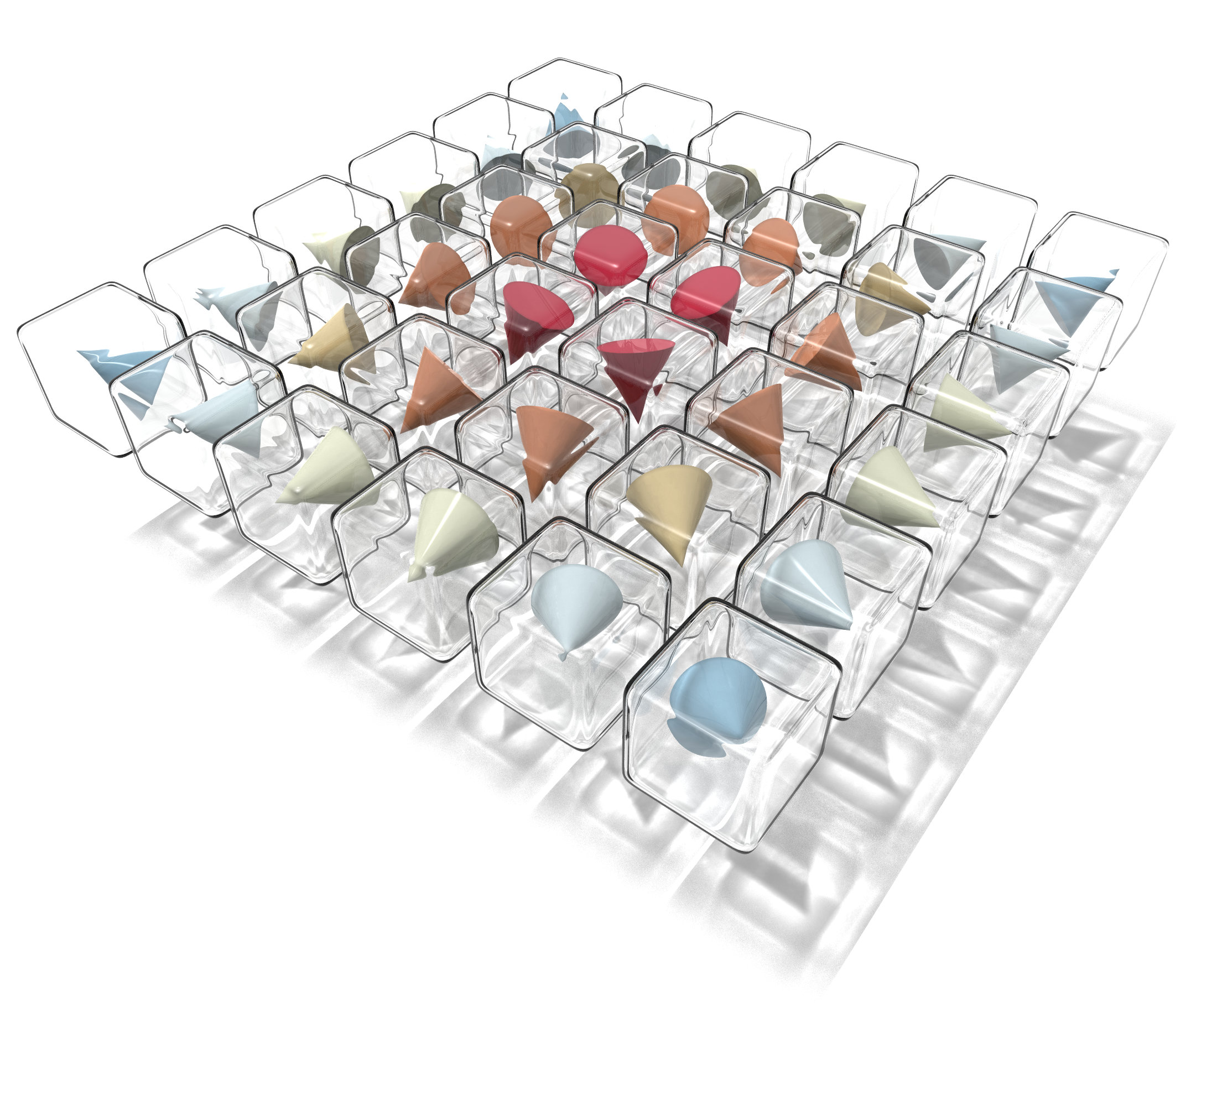
Organisation
Part 0

Slide 3

Acknowledgements
Part 0 - organisation
We acknowledge the IEEE Magnetics Society support.
We thank Xin Fan and Kirill Belashchenko for organising the workshop.

Slide 4
People
Part 0 - organisation
Instructor:
Marijan Beg (@marijanbeg)
Moderators:
Ryan A. Pepper (@rpep)
Hans Fangohr (@fangohr)

Slide 5
Questions
Part 0 - organisation
There are two ways how you can ask a question:
Raise an issue in the workshop repository. (Please be aware that questions and answers can be seen by everybody.)
During live sessions, please send your questions as a private Zoom message to:
Ryan A. Pepper
Hans Fangohr
If you are on Twitch, send your questions there and we are going to find it.
Due to the limited time and a large number of participants, we are not going to be able to answer all questions.
If you do not get an answer during the live session, please raise an issue in the workshop repository.

Slide 6
Sessions
Part 0 - organisation
The workshop is divided into 3 sessions:
(DONE) Basics of micromagnetics, Jupyter, and Python
Thursday 18 June 2020, 12:00-13:30 (ET)
(NEXT) Micromagnetic models and drivers
Thursday 25 June 2020, 12:00-13:30 (ET)
Data analysis and visualisation
Thursday 02 June 2020, 12:00-13:30 (ET)
For each session we only imply what the main focus is going to be.
In each session we are going to be covering all the topics, but at different levels.

Slide 7
aims
Part 0 - organisation
Survey: The majority of participants are PhD students and most people never ran a micromagnetic simulation before.
Our goal is to try to establish a good foundation to make sure that at the end of the workshop you know how to:
Set up and run a micromagnetic simulation in ubermag,
Analyse and visualise the data,
Understand the documentation and learn more advanced topics on your own.

Slide 8

What do I need for the workshop?
Part 0 - organisation
The workshop repository is going to be updated regularly and it is available at:
https://github.com/ubermag/workshop
It contains all the slides, tutorials, exercises, extra materials, and up-to-date information about the workshop.
Tutorials and exercises can be run in the cloud using Binder.
You do not need to install anything and no files will be created on your machine.
Binder can be accessed using Binder badge in the workshop repository:
Starting Binder can take a few minutes, so please be patient.
WARNING: The most recent update of Safari web browser on MacOS sometimes does not interpret the colours well in 3D interactive plots and Google Chrome is recommended.

Slide 9
Installation (oommf vs mumax3)
Part 0 - organisation
Ubermag is a Python package and it can be installed in many different ways (pip, miniconda, anaconda-navigator, docker…)
We recommend the installation using miniconda:
Install Miniconda
conda install —channel conda-forge ubermag
For detailed installation instructions, please follow one of our YouTube videos.
Due to the limited access to GPU machines, we are going to be focusing on OOMMF.
By installing ubermag, OOMMF is going to be installed automatically.
Ubermag interface is the same for both OOMMF and mumax3.
mumax3c is currently available from the development branch, and we expect to demonstrate mumax3c in the last session. The current situation makes it a bit difficult to make a release.

Slide 10


The plan for session 1
Part 0 - organisation
The aim of the workshop is to gain some basic understanding of micromagnetics and to be able to run useful simulations in the end.
Our assumption is no previous experience in micromagnetics, Python, or Jupyter.
In Session 1, we are going to cover only the very basics, so that everybody should be able to follow sessions 2 and 3 (the most exciting things happen later).
topics
goal
Micromagnetics basics
Jupyter basics
First Ubermag simulation
Python basics

Slide 11
The plan for session 2
Part 0 - organisation
In Session 2, we build on top of the basics we introduced in session 1.
We are going to have a look at spatially varying fields, parameters, energy and dynamics equations, as well as periodic boundary conditions.
In addition, we are going to start looking at some data analysis and visualisation methods.
Data analysis and visualisation
topics
goal
Ubermag simulation skeleton
PBC
DW pair to skyrmion
Spatially varying fields

Slide 12
The plan for session 3
Part 0 - organisation
In Session 3, we show some more specialised topics.
We focus on data analysis and visualisation tools.
Data analysis and visualisation
topics
Ubermag summary
Field operations
Time varying fields

Slide 13
Micromagnetics
Part 1

Slide 14
Micromagnetics
Part 1 - micromagnetics
“… is a field of physics dealing with the prediction of magnetic behaviours at sub-micrometer length scales.”
Source: Wikipedia

Slide 15
Magnetisation field
Part 1 - micromagnetics
In continuum approximation, magnetisation is considered to be a continuous vector field.
Magnetisation M(r, t) is a function of both space r and time t.
$$M=M(r,t)$$

Slide 16
Micromagnetic assumptions
Part 1 - micromagnetics
Magnetisation field M(r, t) is differentiable (continuous and slowly changing) with respect to both space r and time t.
The magnetisation field norm is constant (time invariant).
Constant norm |M| is represented by saturation magnetisation Ms.
Very often, magnetisation is represented by a normalised magnetisation field m(r, t).
$$M_{s}=|M|=const.$$
$$m(r,t)=\frac{M(r,t)}{M_{s}}$$
$$|m|={m_{x}}^{2}+{m_{y}}^{2}+{m_{z}}^{2}=1$$

Slide 17
discretisation
Part 1 - micromagnetics
In order to solve the magnetisation field numerically, we have to divide it into smaller “chunks”.
There are two main ways how we can discretise the field:
finite-differences
finite-elements
The discretisation must be:
large enough to ignore the crystal structure of the material (the continuum approximation).
small enough to spatially resolve different magnetisation configurations (like domain walls, vortices, or skyrmions).
?

Slide 18


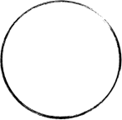




Finite-difference discretisation
Part 1 - micromagnetics
magnetic sample
discretisation cell
lattice unit cell
volume V
M
µi
$$M(r)$$
$$M=\frac{\sum_{i∈V}{μ_{i}}}{V}$$
magnetisation field
discretisation cell coordinate

Slide 19
Discretised Magnetisation field
Part 1 - micromagnetics
discretised field at time ti
In continuum approximation, magnetisation is considered to be a continuous vector field.
Magnetisation M(r, t) is a function of both space r and time t.
In finite-differences, magnetisation field M is discretised (at every time step) so that a single vector is assigned to each discretisation cell.
$$M=M(r,t)$$
M(r1)
M(r2)
M(r3)
…
$$M(r_{i},t_{i})=(M_{x},M_{y},M_{z})$$

Slide 20




Energy equation (HAMILTONIAN)
Part 1 - micromagnetics
… is a mapping of magnetisation field m=m(r, t) to energy density (scalar) field.
By integrating w(m) over the entire sample volume V, the energy functional is
$$w(m)=w_{1}(m)+w_{2}(m)+w_{3}(m)+…=\underset{i}{∑}w_{i}(m)$$
user-defined
$$E[m]=∫_{V}w(m)dV$$
$$m$$
$$\underset{i}{∑}w_{i}(m)$$
$$w(m)$$
$$∫_{V}w(m)dV$$
$$E$$
vector field
scalar field
scalar

Slide 21





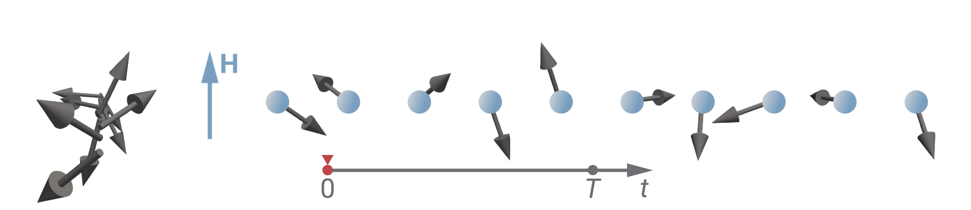
Zeeman
Part 1 - micromagnetics
Aligns m parallel to H.
Parameter: H (A/m)
Parameter in ubermag is H and not B.
H
H
m
m
$$\begin{matrix}w_{z} & =-M⋅B \\ & =-μ_{0}M_{s}m⋅H\end{matrix}$$
$$\left(B=μ_{0}H,M=M_{s}m\right)$$
H

Slide 22







Uniaxial anisotropy
Part 1 - micromagnetics
u
Aligns m along u or perpendicular to u.
Parameters: K (J/m³), u
m
u
u
$$\begin{matrix}w_{ua} & =-K(m⋅u)^{2} \\ & =-K\cos^{2}θ \\ & =-K(1-\sin^{2}θ)=-K+K\sin^{2}θ\end{matrix}$$
$$\left(|m|=1,|u|=1\right)$$
m
K>0
K<0
m
const.
easy-axis
easy-plane
There are several mathematically equivalent ways of writing uniaxial anisotropy.
Changing on the sign of K, changes the “character” of uniaxial anisotropy.
Be careful about the sign of K and if |u|=1.

Slide 23


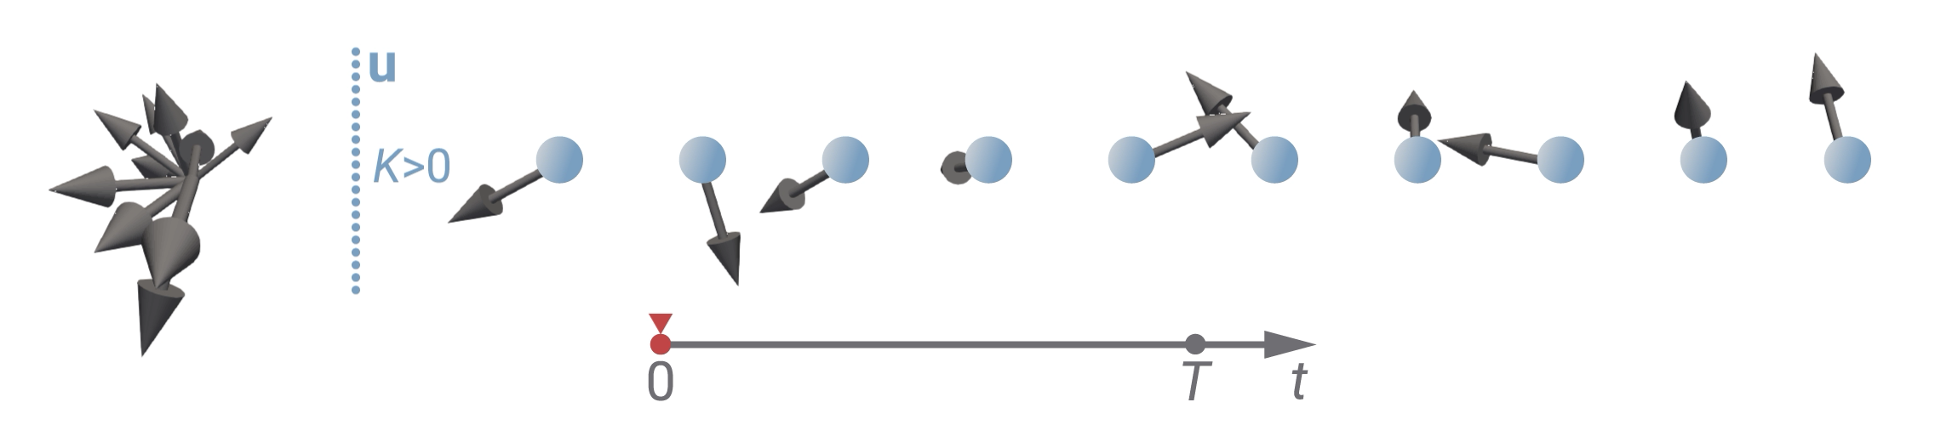
EASY AXIS Uniaxial anisotropy
Part 1 - micromagnetics
Aligns m parallel to antiparallel to u.
Parameters: K>0 (J/m³), u
Be careful that K>0 and |u|=1.
u
u
m
m
$$w_{ua}=-K(m⋅u)^{2}$$
$$\left(|m|=1,|u|=1\right)$$
u
K>0

Slide 24

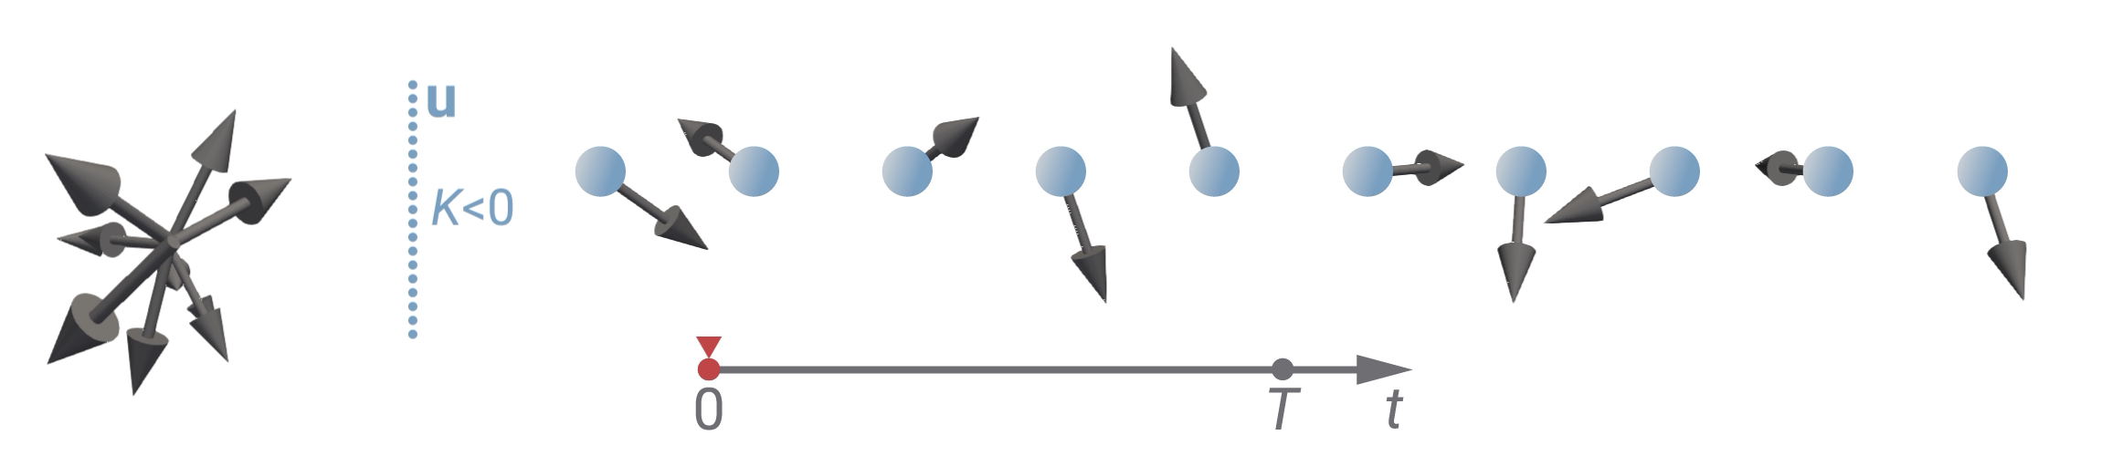
EASY plane Uniaxial anisotropy
Part 1 - micromagnetics
Aligns m perpendicular to u.
Parameters: K<0 (J/m³), u
Be careful that K<0 and |u|=1.
u
u
m
m
K<0
$$w_{ua}=-K(m⋅u)^{2}$$
$$\left(|m|=1,|u|=1\right)$$
u
K<0

Slide 25




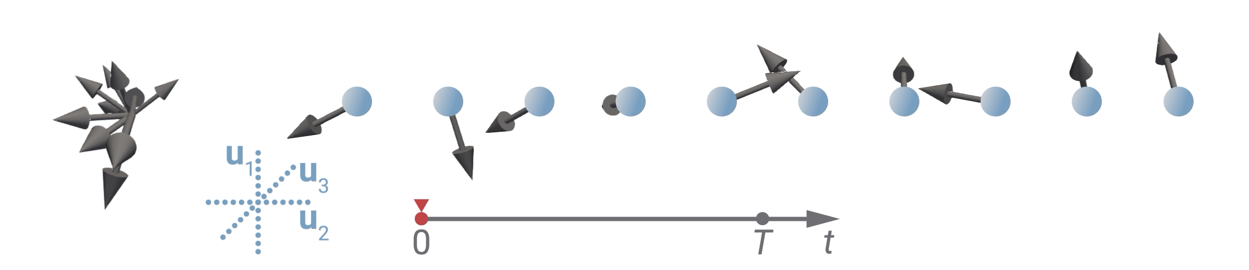
Cubic anisotropy
Part 1 - micromagnetics
Be careful if |ui|=1 and u3 = u1 x u2
Aligns m along u1, u2, or u3.
Parameters: K (J/m³), u1, u2, (and) u3
u1
u1
m
m
u2
u2
$$w_{ca}=-K(m_{1}^{2}m_{2}^{2}+m_{2}^{2}m_{3}^{2}+m_{1}^{2}m_{3}^{2})$$
u3
u3
$$\left(|m|=1,|u|=1,m_{i}=m⋅u_{i}\right)$$

Slide 26






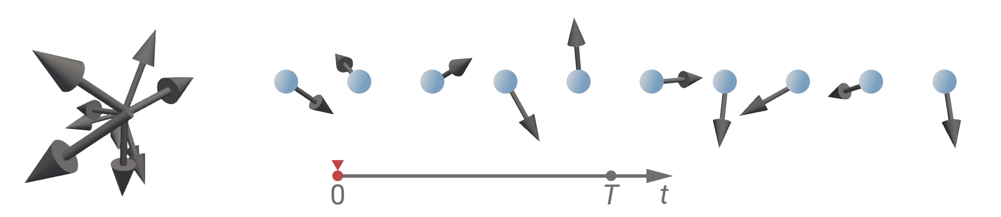
(ferromagnetic) Exchange
Part 1 - micromagnetics
Using A<0 (antiferromagnetic exchange) in micromagnetics is not justified.
Aligns all magnetic moments (in m) parallel to each other.
Parameter: A (J/m)
vector Laplacian
$$\left(∇^{2}m=∇^{2}m_{x}\overset{̂}{x}+∇^{2}m_{y}\overset{̂}{y}+∇^{2}m_{z}\overset{̂}{z}\right)$$
$$\begin{matrix}w_{ex} & =-Am⋅∇^{2}m \\ & =A[(∇m_{x})^{2}+(∇m_{y})^{2}+(∇m_{z})^{2}] \\ & (=)A(∇m)^{2}\end{matrix}$$
m1
m1
m2
m2
just a convention

Slide 27










(atomistic) Dzyaloshinskii-moriya
Part 1 - micromagnetics
Aligns neighbouring magnetic moments (in m) perpendicular to each other and perpendicular to D.
S1
S2
$$w_{ij}^{dmi}=(±)D⋅(S_{i}×S_{j})$$
S1
S1
S2
Be careful about the sign. There is no clear convention.
S2
D
D
T (O), bulk
Cnv interfacial

Slide 28
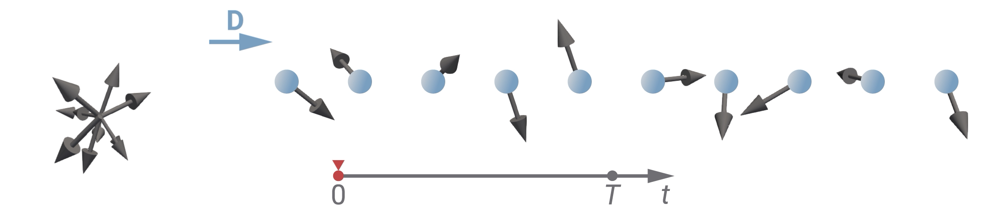

Dzyaloshinskii-moriya (T, o)
Part 1 - micromagnetics
m1
m2
Aligns neighbouring magnetic moments (in m) perpendicular to each other.
Parameter: D (J/m²)
D=Dr12
m1
D>0
D>0
m1
$$w_{dmi}=(±)Dm⋅(∇×m)$$
$$\left(D=Dr_{ij}\right)$$
Be careful about the sign of D. There is no clear convention.
m2
m2
D
D
D

Slide 29


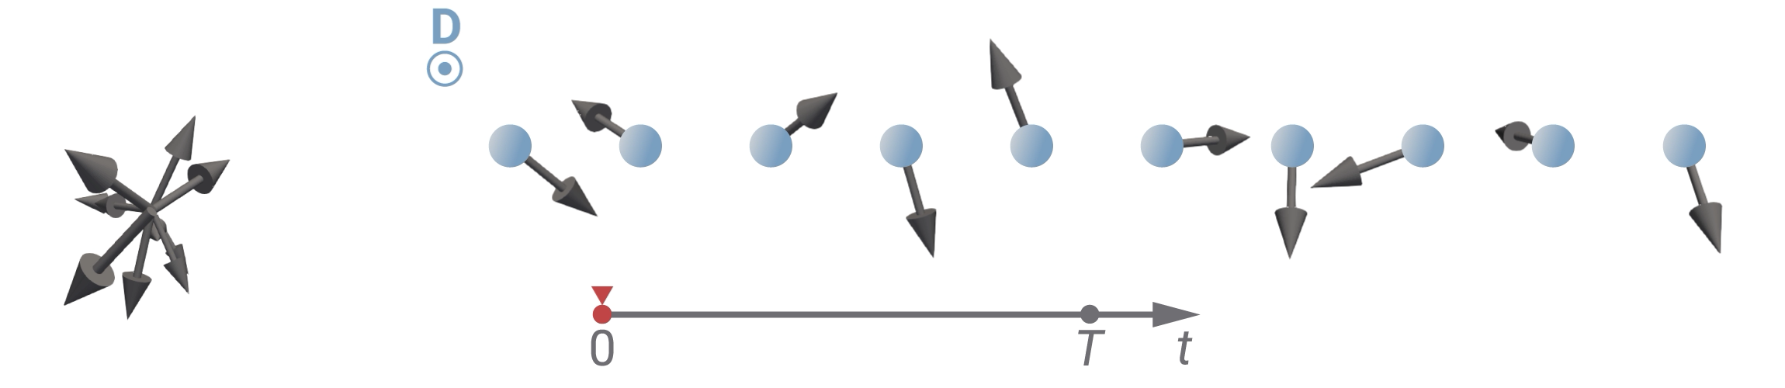
Dzyaloshinskii-moriya (Cnv)
Part 1 - micromagnetics
m1
m2
Aligns neighbouring magnetic moments (in m) perpendicular to each other.
Parameter: D (J/m²)
D=D(r12 x z)
D
m1
D>0
D>0
m1
$$w_{dmi}=(±)D(m⋅∇m_{z}-m_{z}∇⋅m)$$
m2
m2
Be careful about the sign of D. There is no clear convention.
$$\left(D=D(r_{ij}×\overset{̂}{z})\right)$$
D
D
D

Slide 30

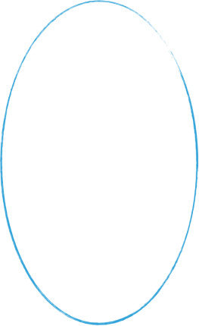



Demagnetisation
Part 1 - micromagnetics
m1
Long range interaction
It is computed from m and no parameter is required.
Each magnetic moment (in m) “feels” the total magnetic field of all surrounding moments.
Computationally expensive.
More details in the next sessions.
m2
m1
m2

Slide 31





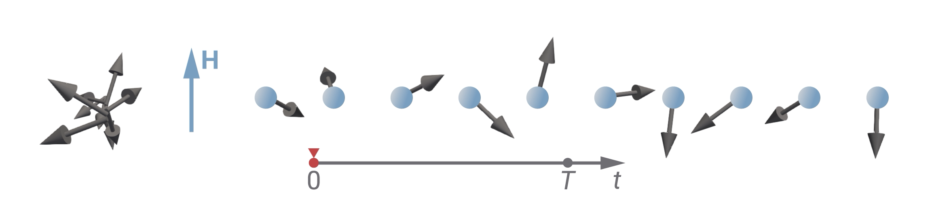
Exchange and zeeman
Part 1 - micromagnetics
H
H
m1
m
m
m1
m2
m2
All magnetic moments parallel to each other?
All magnetic moments parallel to H?
No compromise is needed.
H

Slide 32





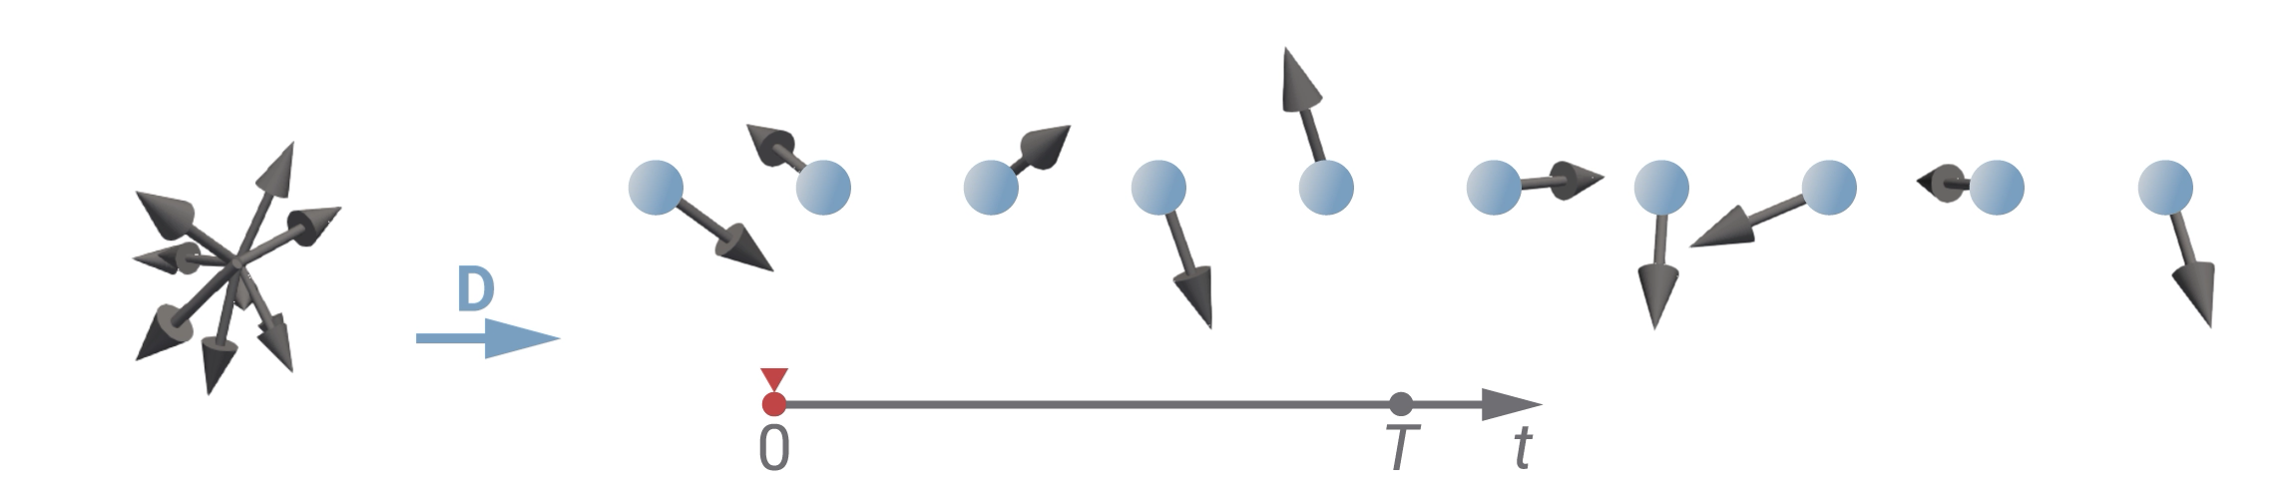
Exchange and dmi (T)
Part 1 - micromagnetics
m1
m1
m2
m1
m1
m2
m2
(D>0)
m2
D
All magnetic moments parallel to each other?
Energies have to compete and reach a compromise.
All magnetic moments perpendicular to each other?
D

Slide 33



More complicated case in a 2d sample (1/2)
Part 1 - micromagnetics
H
H
u
u
m
m
m
m
K>0
Energies have to compete and reach a compromise.
m1
m1
m2
m1
m2
m1
m2
(D>0)
m2
D

Slide 34
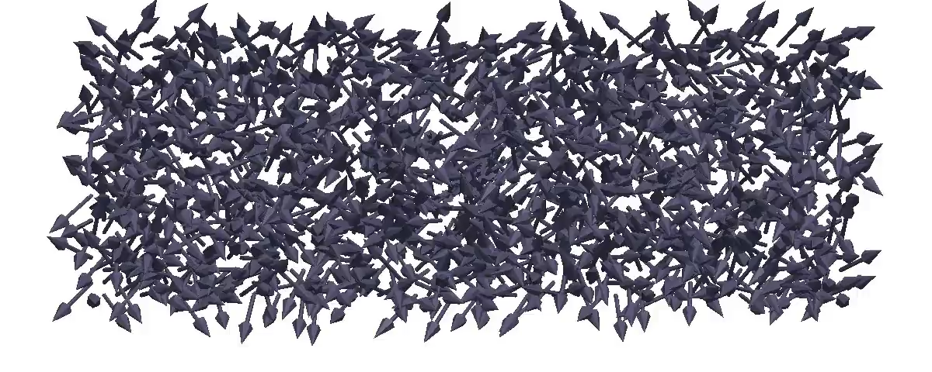
More complicated case in a 2d sample (2/2)
Part 1 - micromagnetics

Slide 35
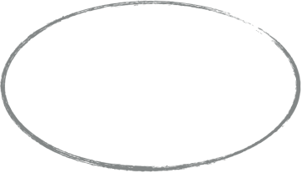


Dynamics equation
Part 1 - micromagnetics
…tells us how magnetisation m wants to change in order to minimise its energy.
$$\frac{dm}{dt}=f_{1}(m,H_{eff},…)+f_{1}(m,H_{eff},…)+…=\underset{i}{∑}f_{i}(m,H_{eff},…)$$
user-defined
Effective field is computed as the first variational derivative of energy density:
$$H_{eff}=-\frac{1}{μ_{0}M_{s}}\frac{δw(m)}{δm}$$
$$m$$
$$w(m)$$
$$-\frac{1}{μ_{0}M_{s}}\frac{δw(m)}{δm}$$
$$H_{eff}$$
$$\frac{dm}{dt}=f(H_{eff},m)$$
$$\frac{dm}{dt}$$

Slide 36





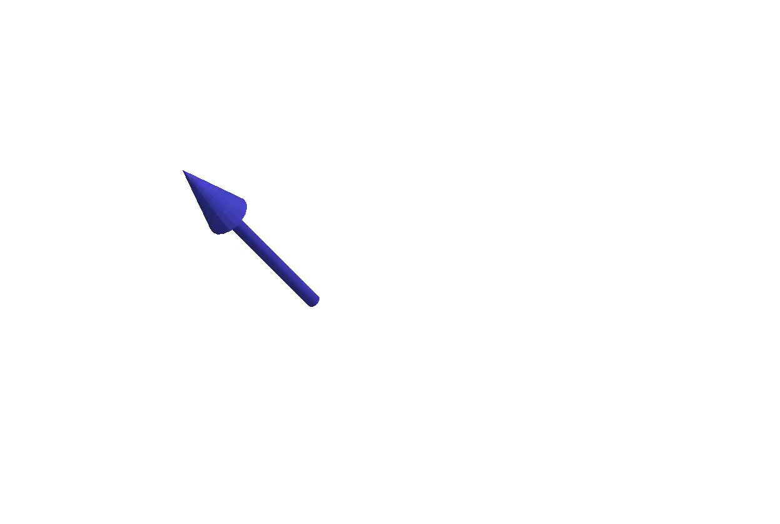



Precession
Part 1 - micromagnetics
Makes m precess around Heff.
Parameter: 𝛾0
Heff
$$\frac{dm}{dt}$$
m
$$\frac{dm}{dt}=-γ_{0}m×H_{eff}$$
$$(γ_{0}=μ_{0}γ)$$
Parameter in Ubermag is 𝛾0, not 𝛾.
Heff
Heff

Slide 37



Gilbert damping
Part 1 - micromagnetics
$$\frac{dm}{dt}$$
Makes m align with Heff.
Parameter: 𝛼
Heff
m
$$\frac{dm}{dt}=α\left(m×\frac{dm}{dt}\right)$$
$$(α>0)$$
Heff
Heff

Slide 38

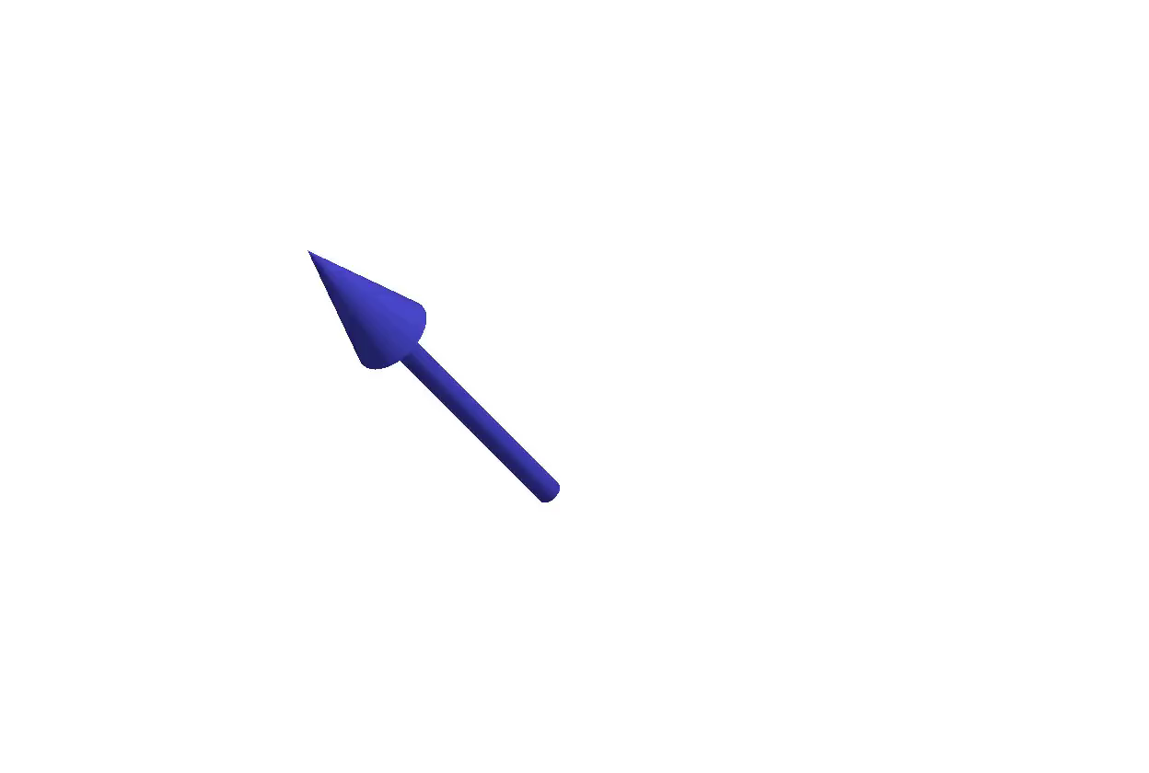



Landau-lifschitz-gilbert equation
Part 1 - micromagnetics
$$\frac{dm}{dt}=-γ_{0}m×H_{eff}+α\left(m×\frac{dm}{dt}\right)$$
$$\frac{dm}{dt}=-\frac{γ_{0}}{1+α^{2}}m×H_{eff}-\frac{γ_{0}α}{1+α^{2}}m×(m×H_{eff})$$
Heff
Heff
Heff
=
+
Heff
Heff
Heff
=
+

Slide 39













(oversimplified) Micromagnetic simulator
Part 1 - micromagnetics
$$\underset{i}{∑}w_{i}(m)$$
$$w(m)$$
$$∫_{V}w(m)dV$$
$$E$$
$$m$$
$$\frac{dm}{dt}=f(H_{eff},m)$$
$$H_{eff}$$
$$-\frac{1}{μ_{0}M_{s}}\frac{δw(m)}{δm}$$
$$Δm$$
$$\frac{dm}{dt}$$
$$\frac{dm}{dt}Δt$$

Slide 40

ubermag simulation skeleton
Part 2

Slide 41
(oversimplified) Micromagnetic simulator
Part 2 - first ubermag simulation
$$\underset{i}{∑}w_{i}(m)$$
$$w(m)$$
$$∫_{V}w(m)dV$$
$$E$$
$$m$$
$$\frac{dm}{dt}=f(H_{eff},m)$$
$$H_{eff}$$
$$-\frac{1}{μ_{0}M_{s}}\frac{δw(m)}{δm}$$
$$Δm$$
$$\frac{dm}{dt}$$
$$\frac{dm}{dt}Δt$$

Slide 42


(oversimplified) Micromagnetic simulator
Part 2 - first ubermag simulation
$$\underset{i}{∑}w_{i}(m)$$
$$w(m)$$
$$∫_{V}w(m)dV$$
$$E$$
$$m$$
$$\frac{dm}{dt}=f(H_{eff},m)$$
$$H_{eff}$$
$$-\frac{1}{μ_{0}M_{s}}\frac{δw(m)}{δm}$$
$$Δm$$
$$\frac{dm}{dt}$$
system
$$\frac{dm}{dt}Δt$$
driver

Slide 43
(oversimplified) Micromagnetic simulator
Part 2 - first ubermag simulation
$$\underset{i}{∑}w_{i}(m)$$
$$w(m)$$
$$∫_{V}w(m)dV$$
$$E$$
$$m$$
m
energy
$$\frac{dm}{dt}=f(H_{eff},m)$$
$$H_{eff}$$
$$-\frac{1}{μ_{0}M_{s}}\frac{δw(m)}{δm}$$
$$Δm$$
dynamics
$$\frac{dm}{dt}$$
system
$$\frac{dm}{dt}Δt$$
driver

Slide 44
(oversimplified) Micromagnetic simulator
Part 2 - first ubermag simulation
$$\underset{i}{∑}w_{i}(m)$$
$$w(m)$$
$$∫_{V}w(m)dV$$
$$E$$
$$m$$
m (df)
energy (mm)
$$\frac{dm}{dt}=f(H_{eff},m)$$
$$H_{eff}$$
$$-\frac{1}{μ_{0}M_{s}}\frac{δw(m)}{δm}$$
$$Δm$$
dynamics (mm)
$$\frac{dm}{dt}$$
system (mm)
df = discretisedfield
mm = micromagneticmodel
mc = oommfc/mumax3c
$$\frac{dm}{dt}Δt$$
driver (mc)

Slide 45
Defining magnetisation field 1/2
Part 2 - first ubermag simulation
mesh = region + discretisation
p2
Ubermag package: discretisedfield
import discretisedfield as df
Region defines the domain in three-dimensional space.
region = df.Region(p1=(…), p2=(…))
Mesh discretises the region
Either discretisation cell size or the number of cells can be defined.
mesh = df.Mesh(region=region, cell=(…)) or
mesh = df.Mesh(region=region, n=(…))
nz
region
ny
p1
nx
dz
dx
dy
discretisation cell

Slide 46
Defining magnetisation field 2/2
Part 2 - first ubermag simulation
discretised field at time ti
Ubermag package: discretisedfield
import discretisedfield as df
Field defines a value at all discretisation cells.
m = df.Field(mesh=mesh, dim=…, value=…, norm=…)
Parameters are:
mesh (df.Mesh)
dim: dimension of the value (int)
value: field value (int, iterable, callable)
norm: vector field norm (int, callable)
M(r1)
M(r2)
M(r3)
…

Slide 47
Defining system object
Part 2 - first ubermag simulation
Ubermag package: micromagneticmodel
import micromagneticmodel as mm
First, we define the system object:
system = mm.System(name=‘my_system_name’)
After that, we define:
system.m = m # the field we defined on previous slide
system.energy = …. # the sum of individual energy terms
system.dynamics = … # the sum of individual dynamics terms

Slide 48
energy equation
Part 2 - first ubermag simulation
Energy equation is a part of the system object.
The system class and energy term classes are a part of micromagneticmodel package.
import micromagneticmodel as mm
First the system object is defined
system = mm.System(name=“system_name”)
Then, energy equation is defined
system.energy = mm.Exchange(A=1e-12) + mm.Demag()

Slide 49
Overview of energy terms we introduced so far
Part 2 - first ubermag simulation
name | parameters | class | comments
Zeeman | H (A/m) | mm.Zeeman | parameter is H not B
uniaxial anisotropy | K (J/m³), u | mm.UniaxialAnisotropy | sign of K, |u|=1
exchange | A (J/m) | mm.Exchange | A<0 not justified
DMI (T, O) | D (J/m²), crystal class | mm.DMI | sign of D
DMI (Cnv) | D (J/m²), crystal class | mm.DMI | sign of D
cubic anisotropy | K (J/m³), u1, u2 | mm.CubicAnisotropy | sign of K, |ui|=1
demagnetisation | None | mm.Demag | computationally expensive
RKKY | sigma, sigma2 | mm.RKKY | defined between subregions

Slide 50
Dynamics equation
Part 2 - first ubermag simulation
Dynamics equation is a part of the system object.
The system class and dynamics term classes are a part of micromagneticmodel package.
import micromagneticmodel as mm
First the system object is defined
system = mm.System(name=“system_name”)
Then, energy equation is defined
system.dynamics = Precession(gamma0=……) + mm.Damping(alpha=…)

Slide 51
Overview of dynamics terms
Part 2 - first ubermag simulation
name | parameters | class | comments
precession | 𝛾0 | mm.Precession | parameter is 𝛾0 not 𝛾
damping | 𝛼 | mm.Damping | 𝛼 > 0
Zhang-Li | u, beta | mm.ZhangLi | in x-direction
Slonczewski | J, mp, lambda | mm.Slonczewski

Slide 52
Drivers
Part 2 - first ubermag simulation
There are two main types of drivers and they are a part of a specific micromagnetic calculator
import oommfc as mc
Minimisation driver
iterates until m x Heff = 0
md = oc.MinDriver()
Time driver
iterates until the maximum time is reached
td = oc.TimeDriver()
After the driver is defined, it is applied to the system object using drive method
td.drive(system)

Slide 53
Computational workflow
Part 3

Slide 54
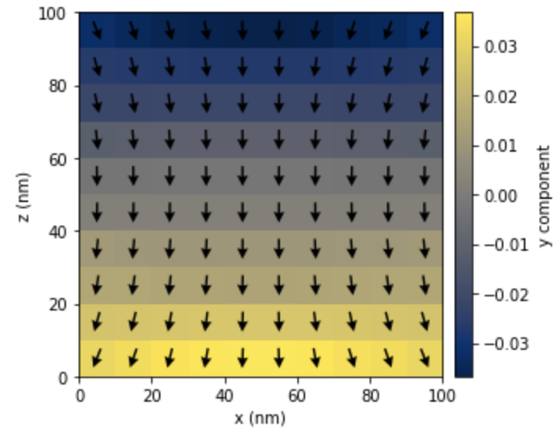
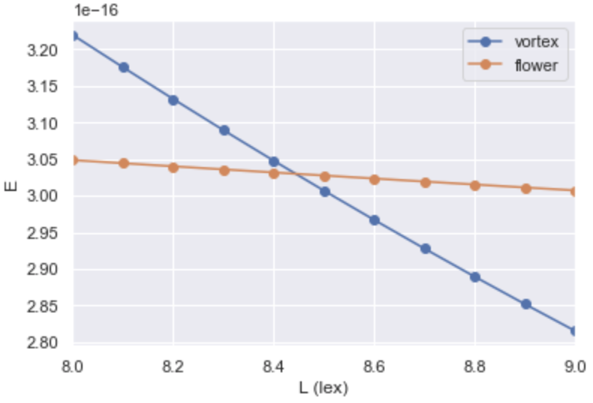


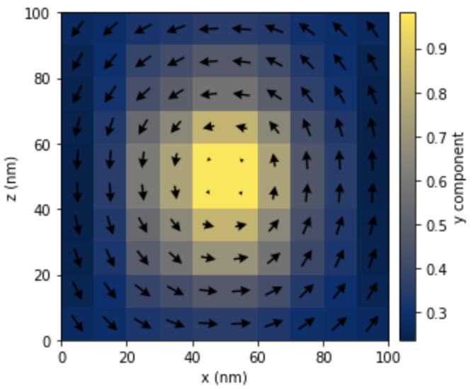

Case study: standard problem 3
Part 3 - computational workflow
flower
L
?
vortex
Research question: For what cube edge length L, vortex and flower states have the same energy?

Slide 55
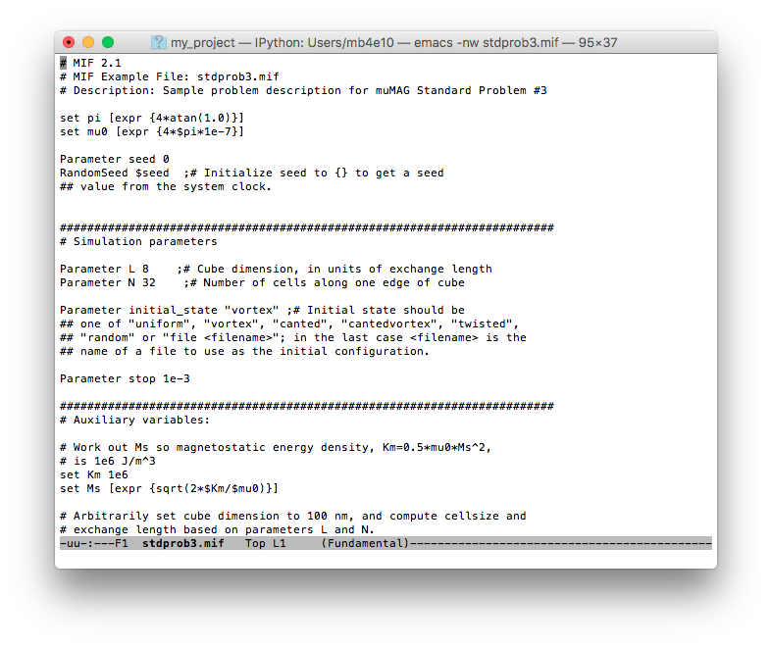
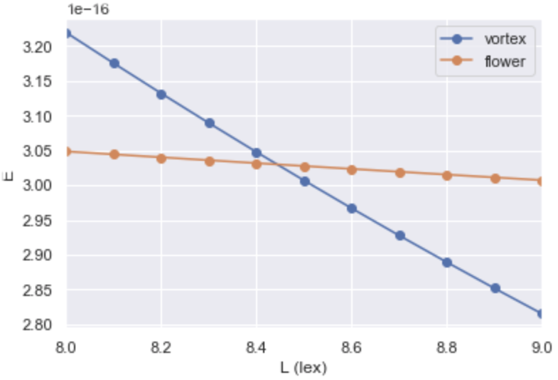


Step 1: write configuration file
Part 3 - computational workflow

Slide 56
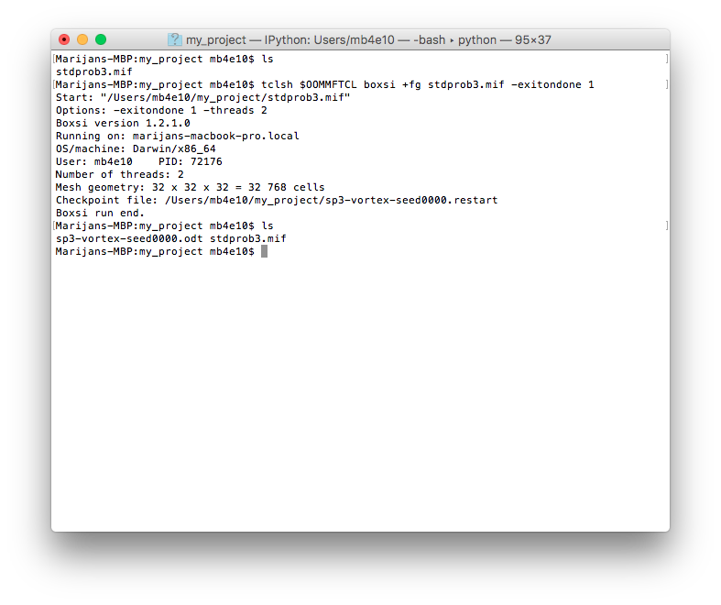


Step 2: run simulation
Part 3 - computational workflow
1. configuration file
2. run OOMMF
3. output file

Slide 57
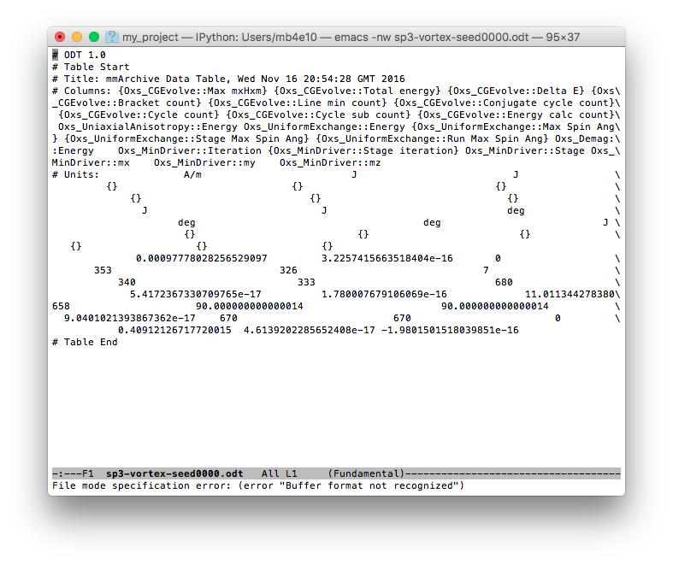



Step 3: read results
Part 3 - computational workflow
vortex energy

Slide 58


Loop through steps 1, 2, 3…
Part 3 - computational workflow
L | flower | vortex
8.0 | ? | 3.23x10⁻¹⁶
8.1 | ? | ?
8.2 | ? | ?
8.3 | ? | ?
8.4 | ? | ?
8.5 | ? | ?
8.6 | ? | ?
8.7 | ? | ?
8.8 | ? | ?
8.9 | ? | ?
9.0 | ? | ?

Slide 59
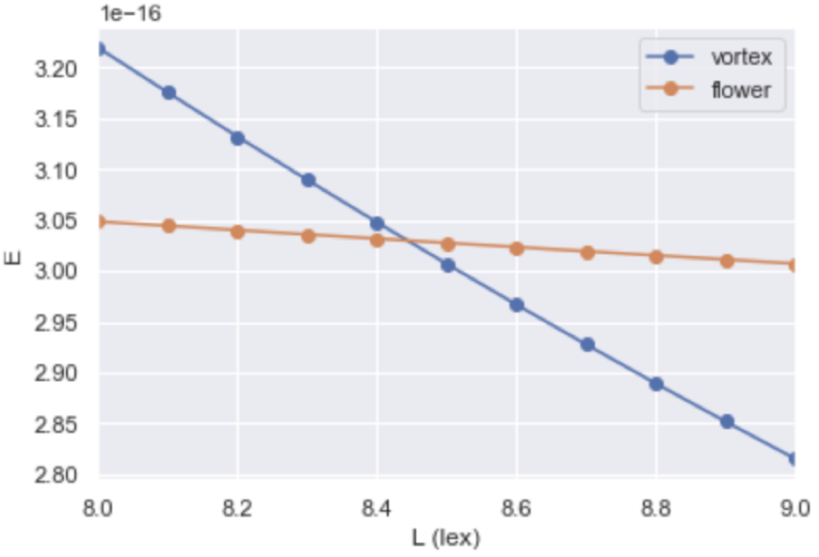

Last step: postprocessing
Part 3 - computational workflow
After we obtained all data points, we plot the results and find crossing.
For this step, we often use separate plotting scripts or graphical user interface (GUI).
very often using “eye-norm”

Slide 60


Workflow summary
Part 3 - computational workflow
write configuration file
run simulation
read results
postprocessing

Slide 61
What could be the problems with this workflow?
Part 3 - computational workflow
Time consuming
It requires a lot of user input
Keeping log of all steps that were run and in what order
I clicked here, then I changed that, then I fixed that…
Separate postprocessing scripts
Every group has their own scripts with different dependencies
Sharing the exact workflow
Reproducibility
Very difficult to automate
Very steep learning curve

Slide 62
Ubermag
Part 4

Slide 63
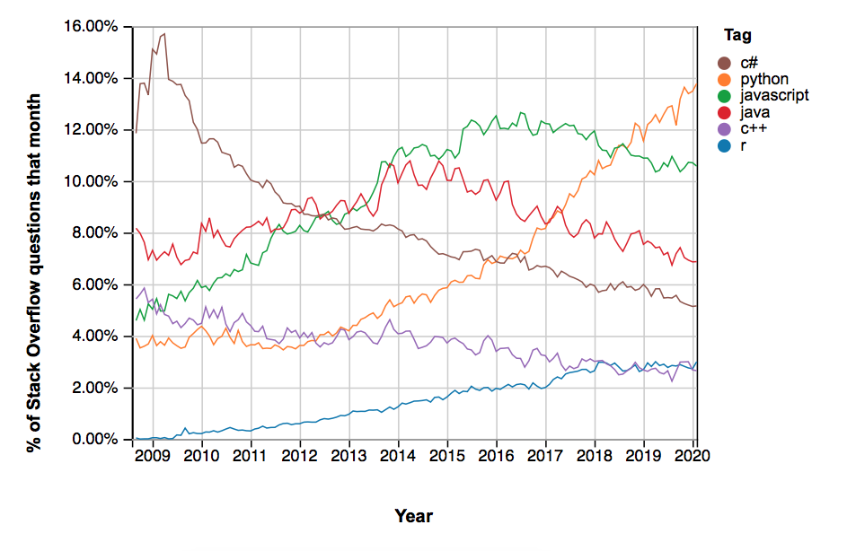
Why did we choose Python?
Part 4 - Ubermag
Modern programming language
The language core is easy to read and easy to learn
Increasingly popular in software engineering
The most popular in computational and data science
Very well documented and well supported
Interpreted language
www.python.org
Hans Python book
Source: https://towardsdatascience.com

Slide 64
Scientific python ecosystem
Part 4 - Ubermag
numpy: linear algebra
scipy: numerical analysis
matplotlib: 2d (and some 3d) plotting
pandas: big data for Python
scikit-learn: machine learning
Jupyter Notebook
No need to reinvent the wheel.

Slide 65

Jupyter
Part 4 - Ubermag
Executable document
Text, equations, images, code, and results in a single document
Easily shared
Easily reproducible
Hosted in web browser
Can be run in the cloud (Binder)
www.jupyter.org

Slide 66
Ubermag
Part 4 - Ubermag
“… provides Python interface to OOMMF and mumax3 (for now), exposes micromagnetic simulations to Python’s scientific ecosystem, and embeds them into Jupyter notebook.”

Slide 67
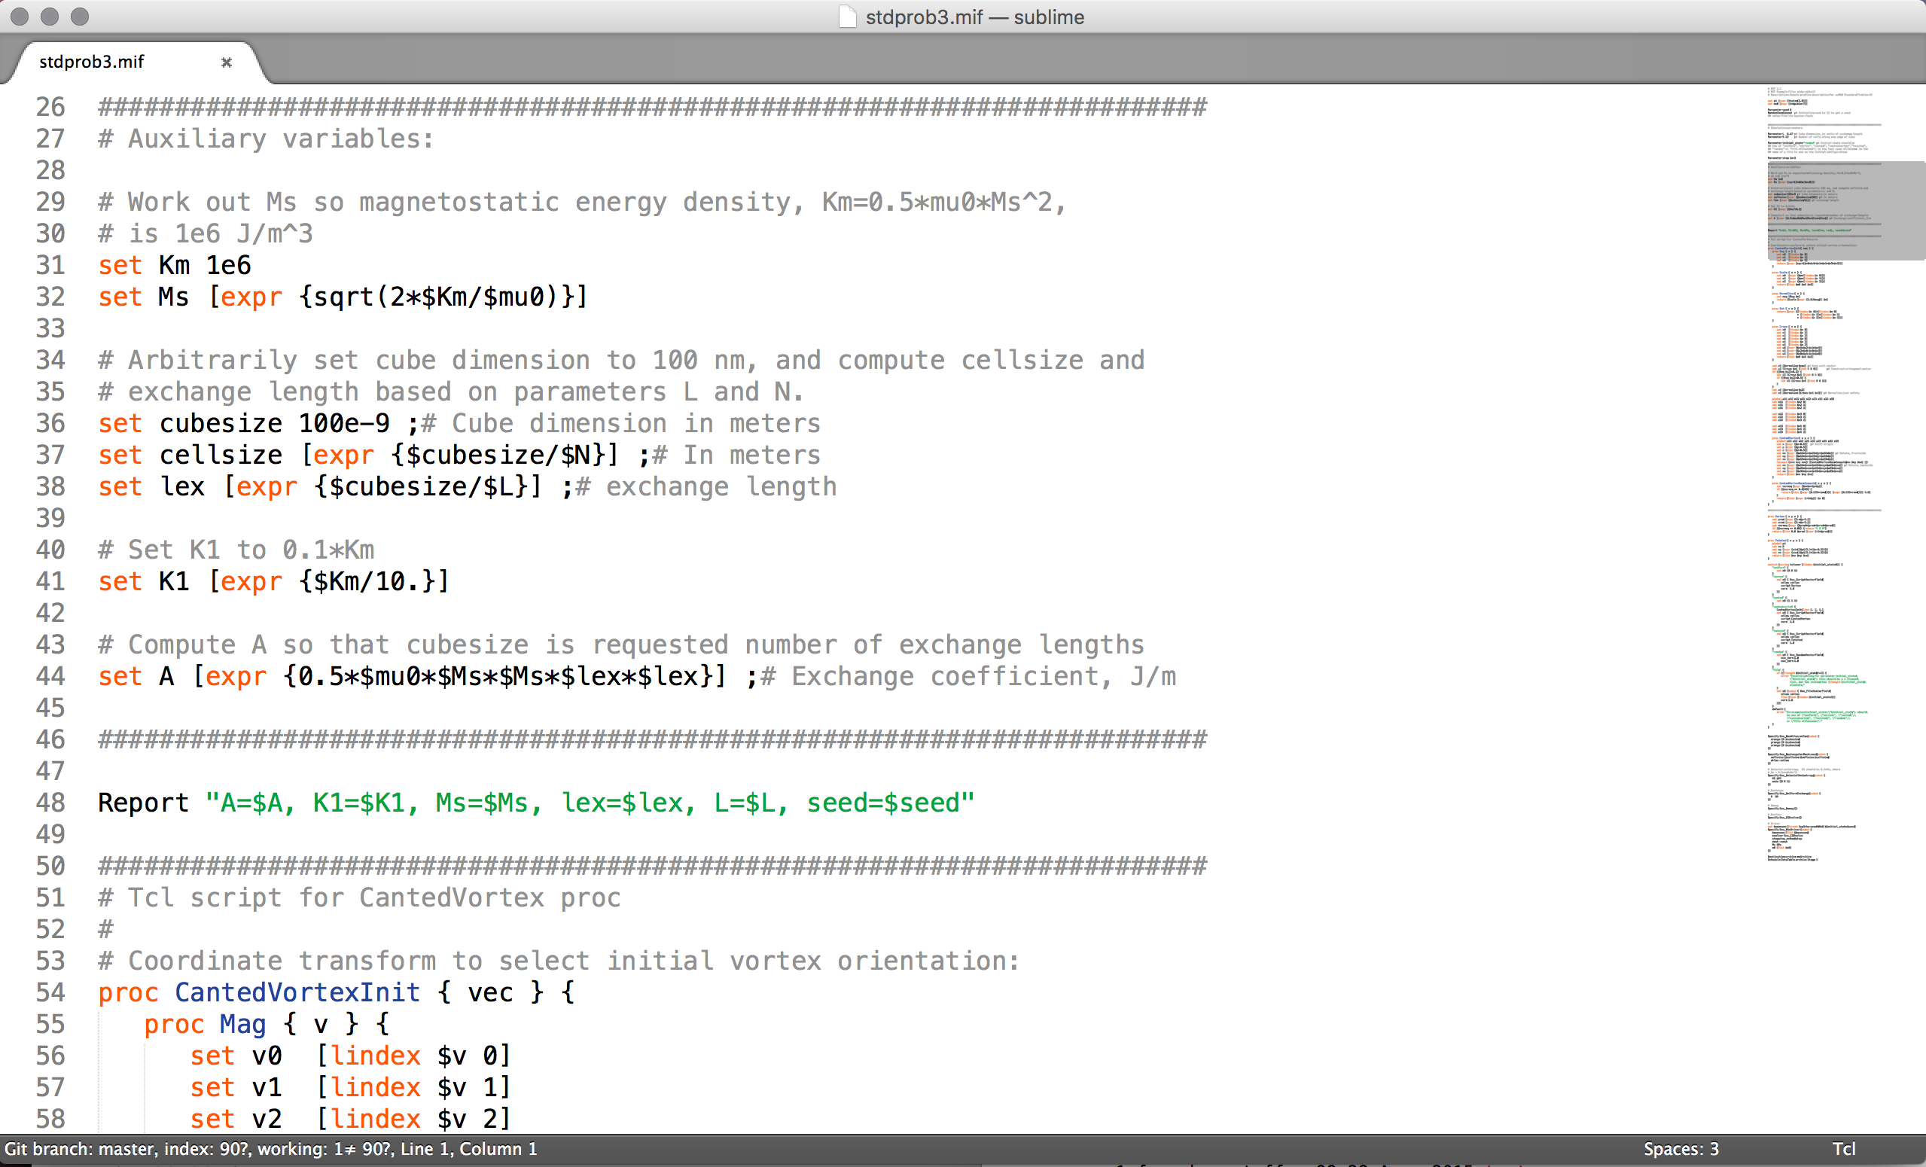
Why did We start with Oommf?
Part 4 - Ubermag
Probably the most widely used micromagnetic simulation tool
Developed at NIST, US, since ~1998 by Michael Donahue & Don Porter
Cited over 2200 times in scientific publications
Written in C++ & Tcl
Finite-difference code
Very often used for comparisons between codes (stdprob url…)
https://math.nist.gov/oommf/

Slide 68
Ubermag Documentation
Part 4 - Ubermag
GitHub organisation: https://github.com/ubermag
Each package has an online documentation:
[package_name].readthedocs.io
There is API Reference which is always up-to-date and covers 100% of functionality.
Tutorials as Jupyter notebooks provide the summary of functionalities in a certain context
Available in the cloud - Binder
Does not cover all functionality

Slide 69
Support
Part 4 - Ubermag
Functionality requests, bug reports, general support
The preferred way is to raise an issue in help repository:
https://github.com/ubermag/help
There is a permanent record of communication
There is a chance, somebody already asked a similar question
Do not ask confidential questions!
Please be patient (it’s a small team)

Slide 70
Licence
Part 4 - Ubermag
BSD-3-Clause
You can do with the code whatever you want
Obligations
You have to cite
If you modify the code, you must copy the licence file and acknowledge the source

Slide 71
We kindly ask you to…
Part 4 - Ubermag
Support the software by citing
Contribute
Complete our survey

Slide 72
Support the software by citing in your publications
Part 4 - Ubermag
M. Beg, R. A. Pepper, and H. Fangohr. User interfaces for computational science: A domain specific language for OOMMF embedded in Python. AIP Advances 7, 56025 (2017). https://doi.org/10.1063/1.4977225
Depending on the computational backend you use:
OOMMF
mumax3

Slide 73
Please contribute
Part 4 - Ubermag
We welcome all types of contributions
Extensions
Documentation
Example notebooks - tutorials
YouTube videos
Bug reports
Bug fixes
Reply to other user queries
Typos/grammar
…
If there is anything you would like to contribute to, but you are not sure how, please let us know.

Slide 74
Survey
Part 4 - Ubermag
We ask you ALL to complete our survey.
You do not have to give us your personal information and all questions are optional.
Organisers are going to send you the link by email.
Link is also going to be available in our workshop repository.

